Slide 1
Modernizing Quality Assessment through Automation:
ONDP/Division of Biopharmaceutics
Automation Tool Application
Nov 16, 2018
Ho-Pi Lin, Ph.D.
Division of Biopharmaceutics, Branch III
FDA/CDER/Office of Pharmaceutical Quality (OPQ)/
Office of New Drug Products (ONDP)

Slide 2
Disclaimer
This presentation reflects the views of the presenter and should not be construed to represent FDA’s views or policies.

Slide 3
Outline
Overview: review responsibilities in the Division of Biopharmaceutics
Dissolution test and product quality assessment
Automation tool for dissolution evaluation
  Dissolution profiles comparison
  Simulation to help assess dissolution acceptance criteria
Summary
Looking forward

Slide 4
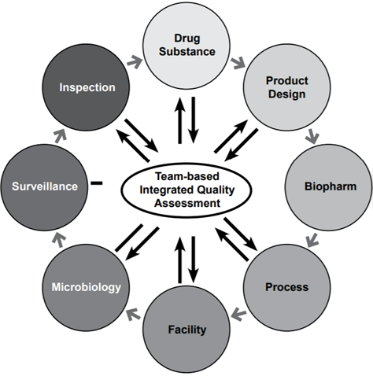
FDA Pharmaceutical Quality
One Quality Voice
Establishing:
Patient Focused Quality Standard
Finding:
In Vitro-In Vivo Link for Pharmaceutical Manufacturing and Quality
Our Goal
Figure modified from: https://www.fda.gov/downloads/AboutFDA/CentersOffices/OfficeofMedicalProductsandTobacco/CDER/UCM442666.pdf

Slide 5
Dissolution Test:
Crucial in Product Quality Assessment
Applicable to multiple dosage forms:
Tablets, Capsules, Implants, Powders, inserts, suspensions, etc.
Assessment involved | Frequently used in
Dissolution profiles comparison f2 testing for highly variable dissolution: Multivariate confidence region procedure (MVA Test) f2 bootstrapping | Pharmaceutical Development Biowaivers Interchangeability Evaluation Scale-up and Post-Approval Changes (SUPAC)
Dissolution acceptance criteria | Routine Quality Control Stability Studies

Slide 6
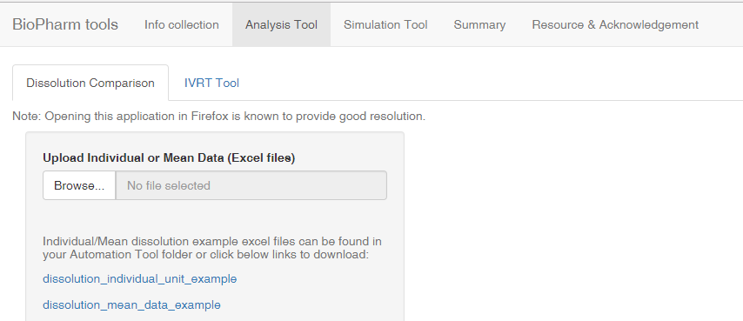
Dissolution Profiles Comparison
Upload the dissolution data file

Slide 7
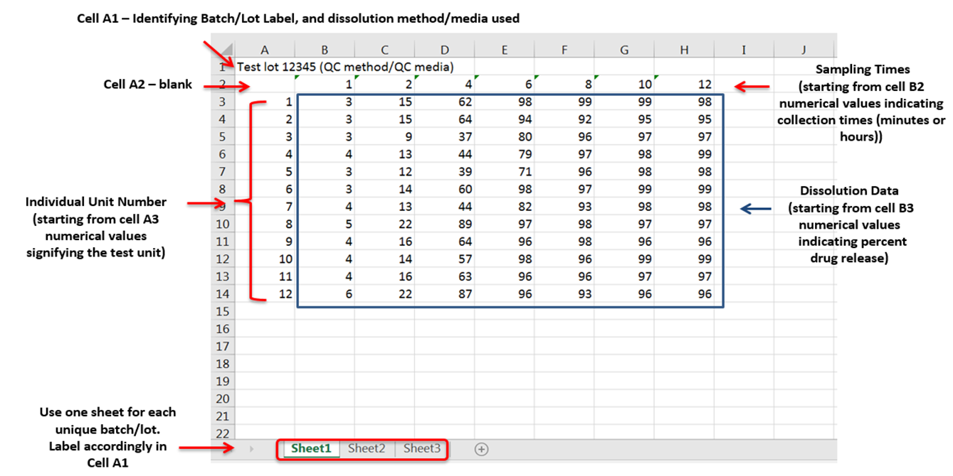
Dissolution data input in Excel spreadsheet

Slide 8
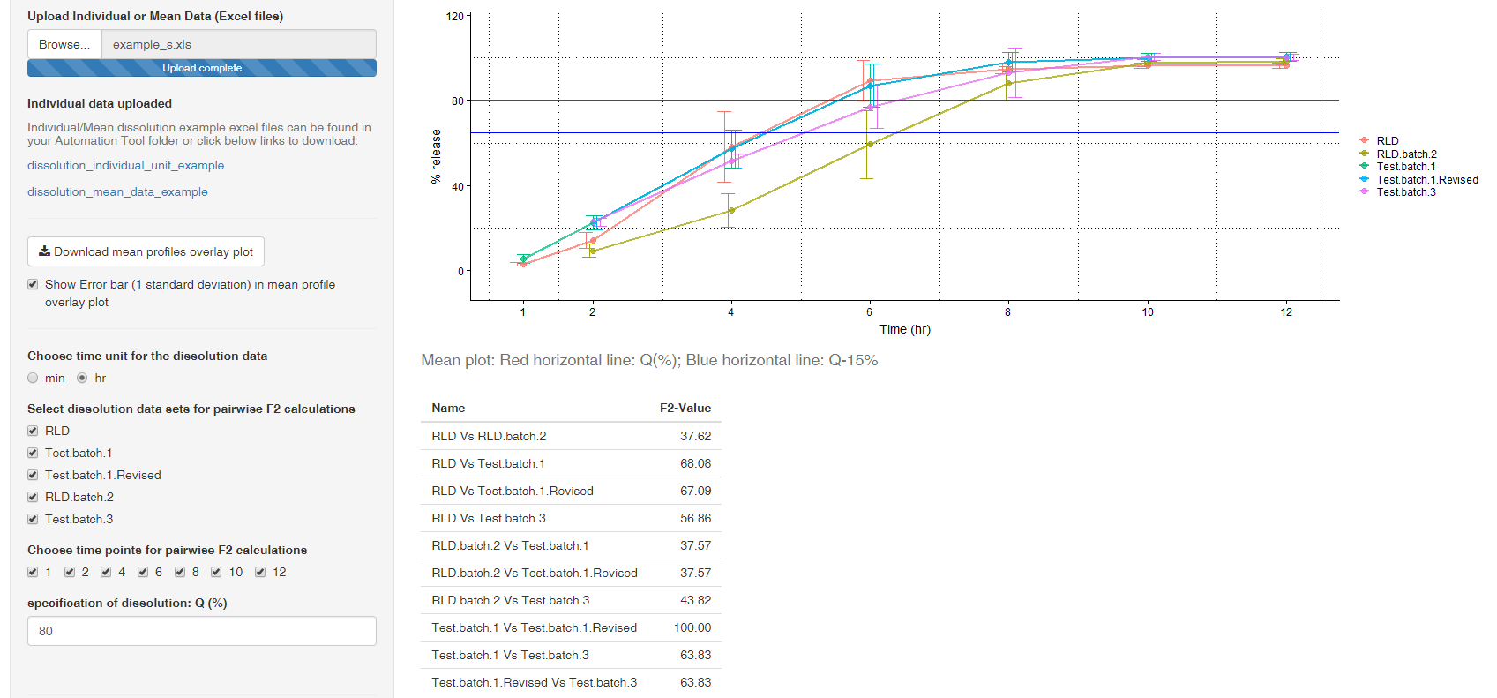
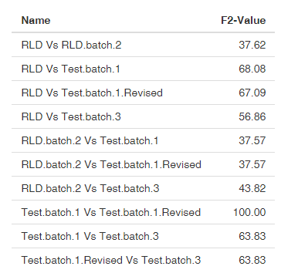
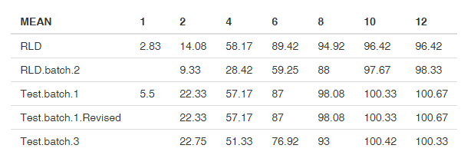
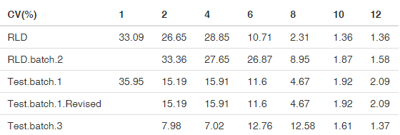
Dissolution Profiles Comparison (Cont.)

Slide 9
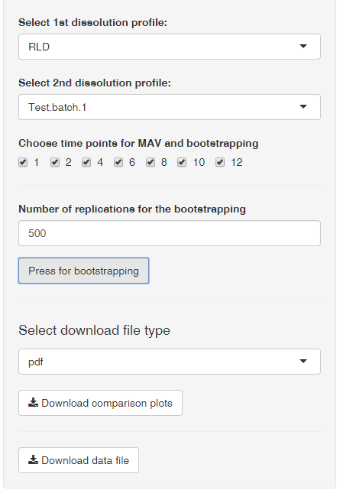
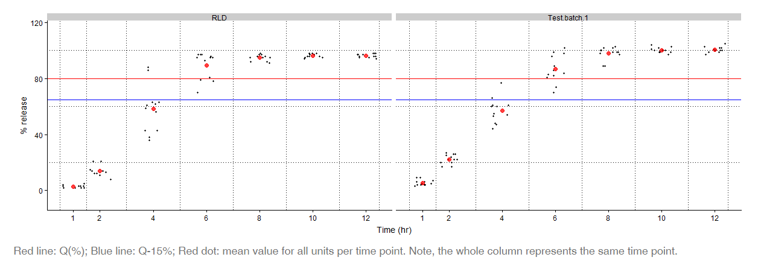
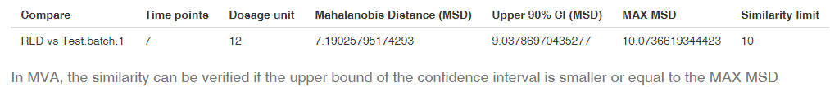
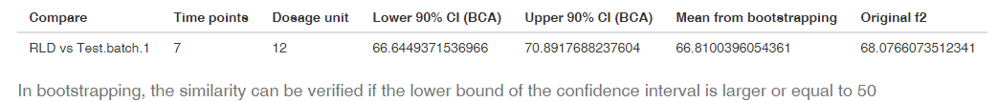
Dissolution Profiles Comparison (Cont.)
MVA test
Bootstrapping test

Slide 10
Dissolution Acceptance Criteria Assessment
Simulation Tool
To visualize appropriateness of a proposed/recommended acceptance criteria
To estimate the pass rate (as per USP guidelines) for a proposed/recommended acceptance criteria
Assumptions:
The dissolution data of BE/clinical batch (mean and %CV) is representative
Normal distribution of the dissolution data

Slide 11
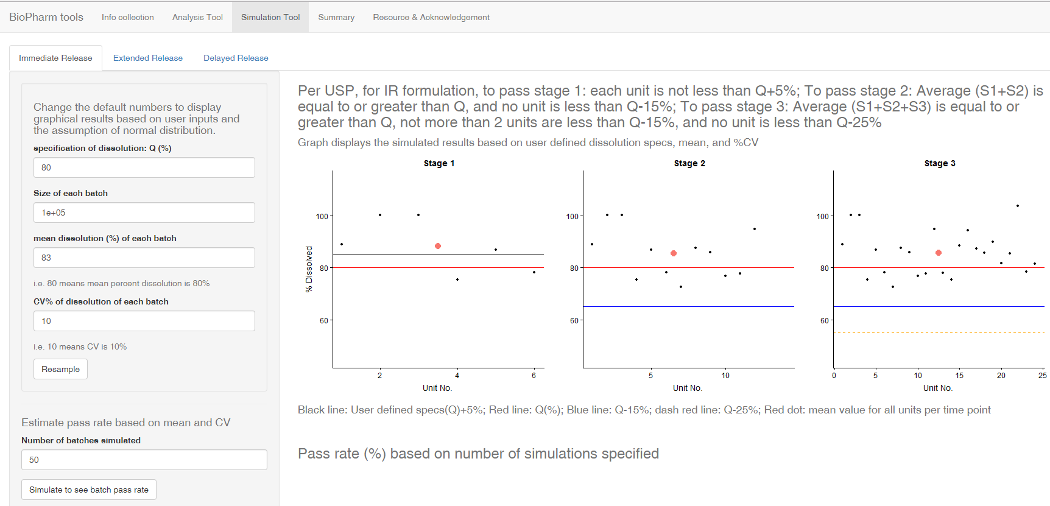
Simulation Tool:
Immediate release formulation
graphic presentation will change according to new sampling

Slide 12
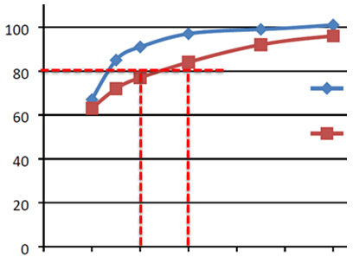
Example: IR product (BCS Class II API)
D90 = 40.5 µm
D90 = 99.8 µm
10 20 30 40 50 60
With the acceptance criterion set at “Q=80% at 20 minutes”
Pass Stage 1 (%) | Pass Stage 2 (%) | Pass Stage 3 (%) | No. of simulations | Mean release (%) | CV (%) | Q (%)
0.00 | 4.00 | 4.2 | 500 | 77 | 8.4 | 80
With the acceptance criterion set at “Q=80% at 30 minutes”
Pass Stage 1 (%) | Pass Stage 2 (%) | Pass Stage 3 (%) | No. of simulations | Mean release (%) | CV (%) | Q (%)
0.00 | 98.00 | 100.00 | 500 | 83 | 6.2 | 80

Slide 13
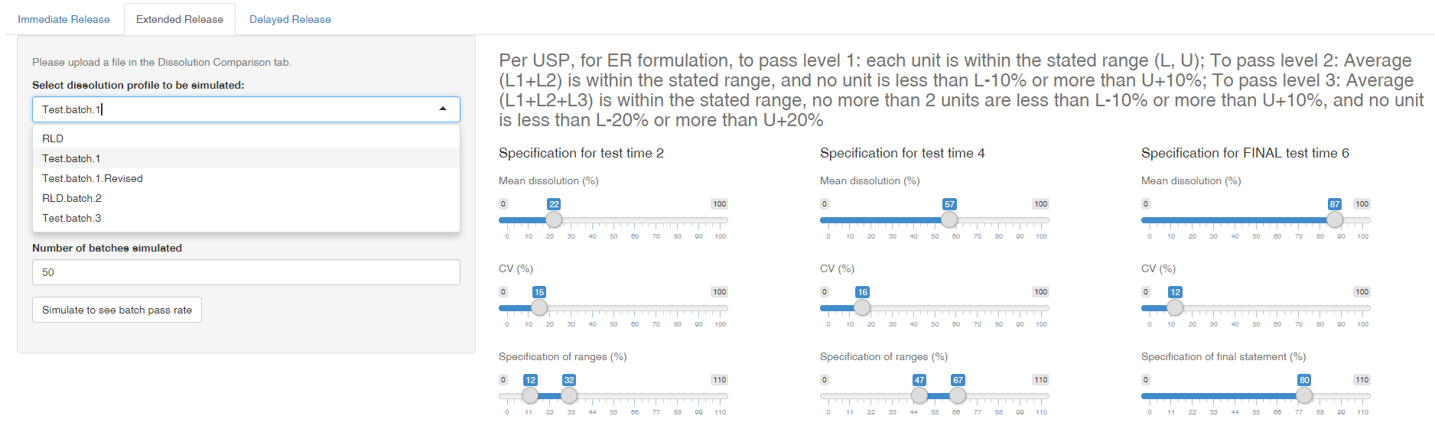

Simulation Tool:
Extended release formulation

Slide 14
Summary
OPQ/ONDP/Division of Biopharmaceutics utilizes automation to streamline, improve efficiency and homogenize the review process
The Automation Tool provides:
  graphical output for dissolution profiles
  automatic statistical analyses for profiles comparison
  simulation to help determine clinical relevant dissolution acceptance criteria

Slide 15
Looking Forward
Division of Biopharmaceutics in Office of New Drug Products continues to explore ways to establish the in vitro – in vivo link for pharmaceutical manufacturing quality
G-SRS provides a comprehensive framework, where quality specifications and corresponding clinical information can be captured
Division of Biopharmaceutics is looking for ways to leverage the power of the G-SRS framework, and develop functionalities tailored to meet the needs of quality assessment, i.e. evaluating linkage between product quality attributes and clinical performances (PK data and quality related adverse events)

Slide 16
Acknowledgments
(arranged alphabetically by first names)
  Barbara Scott
  Brian Connell
  Cong Wu
  Dali Zhou
  David Green
  Gerlie Gieser
  Hansong Chen
  Heng Xu
  Ho-Pi Lin
  Jie Xue
  Joan Zhao
  Mei Ou
  Min Li
  Parnali Chatterjee
  Poonam Delvadia
  Qi Zhang
  Rohit Tiwari
  Yushi Feng
  Working group
  Leadership team
  Angelica Dorantes
  Giuseppe Randazzo
  Kimberly Raines
  Okpo Eradiri
  Paul Seo
  Ramesh Sood
  Scott Furness

